Slide 1


Slide 2

Before we start… What is student´s representation about?

Slide 3
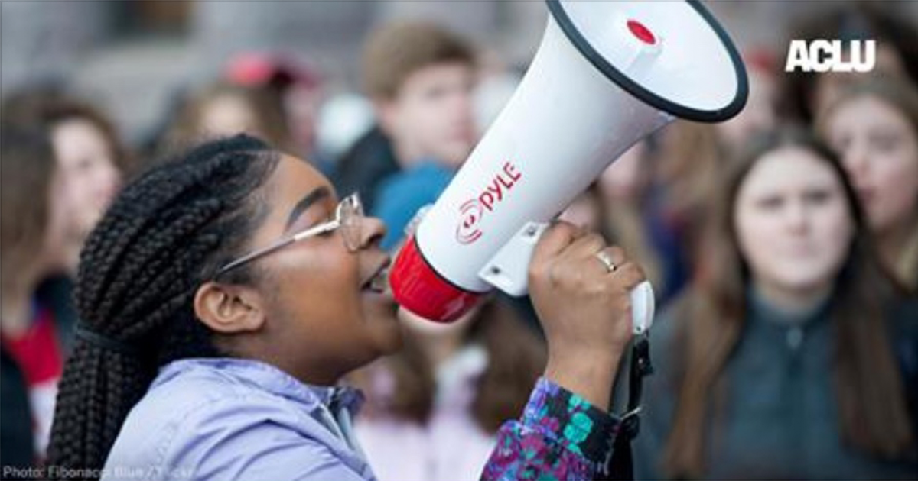
What is student´s representation about?
A student representation is a curricular or extra-curricular activity for students at schools or universities.
Its task consists on getting student matters get resolved as long as possible. They are supposed to be a link bewteen the institution and the different student´s groups.

Slide 4

Roadmap
Core Use Case
Team Members
A+ Description
Prospective Planning
Prospective Budget

Slide 5

Core use case - Proclaims
Students can publish proclaims. Every proclaim must store a ticker, a title, a description, the moment when it is created, and some attachments.
There are a lot of kind of proclaims understood under Category´s name. Teachers proclaims, Building Infraestructure Proclaim, Teaching Schedule or even bullying.

Slide 6

Core use case - Proclaims
Proclaims will be attended by members. For every proclaim, members will have to accepted or rejected it. In the first case, a law must be attached. If rejected, a reason must be provided.

Slide 7

Core use case - Proclaims
If a proclaim is accepted, member and student are allowed to create commentaries about it. Every commentary must have a short description and some optional attachments.

Slide 8
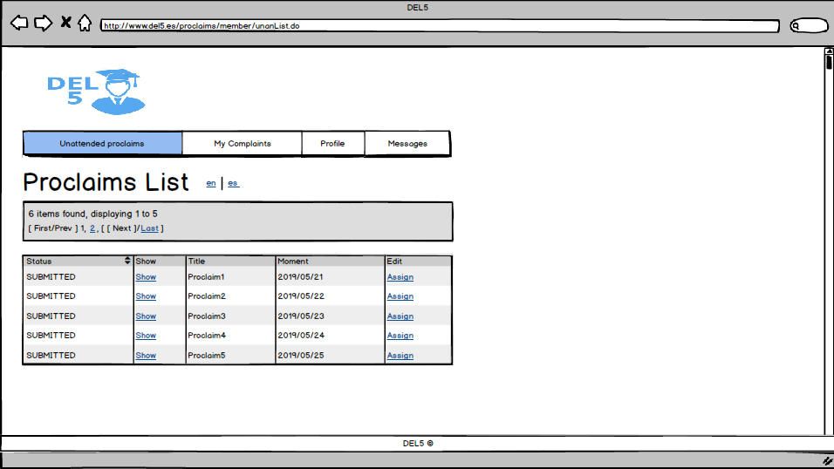
Core use case - Proclaims

Slide 9
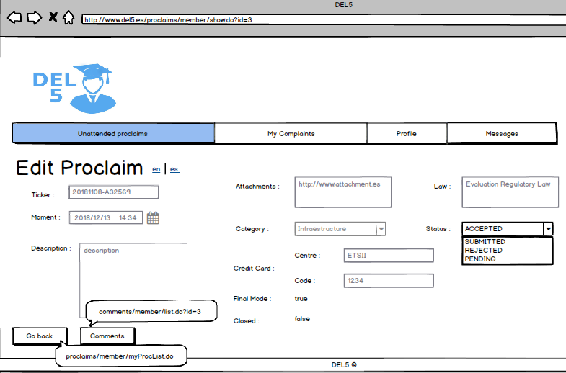
Core use case - Proclaims

Slide 10
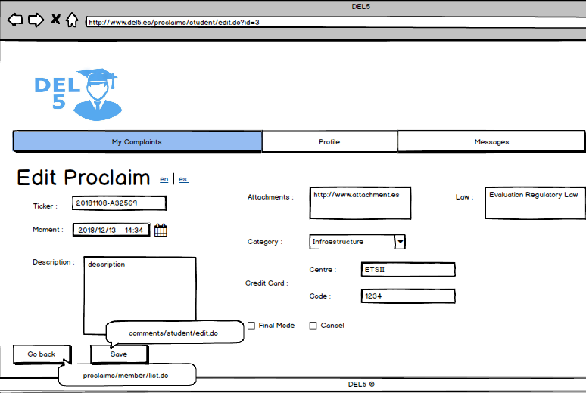
Core use case - Proclaims

Slide 11
Roadmap
Core Use Case
Team Members
A+ Description
Prospective Planning
Prospective Budget

Slide 12
Team members
Belén Garrido
Alejandro Rodríguez
Ángel Delgado
Ezequiel Portillo
Mª De Gracia Piñero

Slide 13
Roadmap
Core Use Case
Team Members
A+ Description
Prospective Planning
Prospective Budget

Slide 14
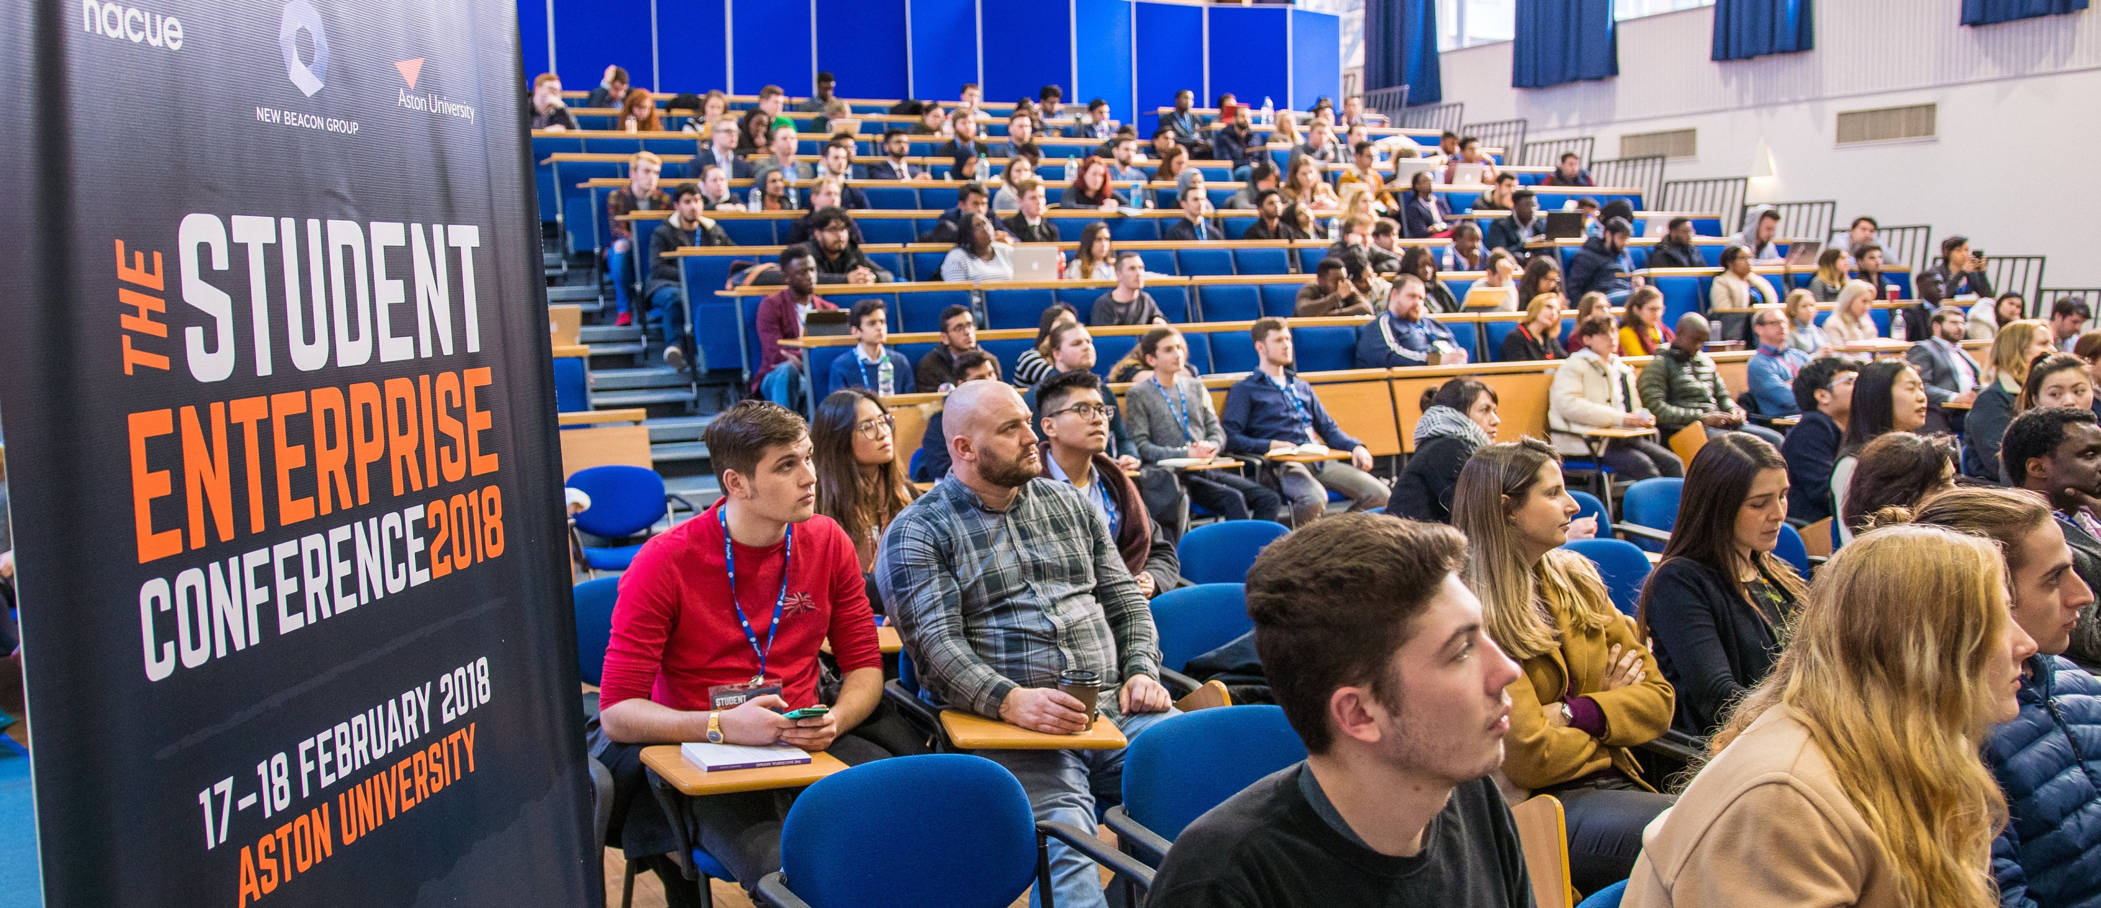
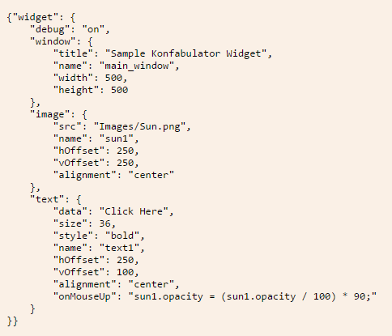

A+ Description

Slide 15
Roadmap
Core Use Case
Team Members
A+ Description
Prospective Planning
Prospective Budget

Slide 16
Prospective Planning
Monday | Tuesday | Wednesday | Thursday | Friday | Saturday | Sunday
 |  |  |  |  |  | 28 Team Meeting
29 | 30 | 1 | 2 | 3 | 4 Team Meeting | 5
6 | 7 | 8 | 9 | 10 | 11 | 12 Team Meeting
13 | 14 | 15 | 16 | 17 Presentation | 18 Have fun | 19 Team Meeting
20 | 21 | 22 | 23 Team Meeting | 24 A+ Tutorial Generic Controller | 25 | 26 Team Meeting
27 | 28 Laboratory | 29 | 30 Pre Production | 31 A+ Tutorial Caching Data | 1 Final Revision | 2
3 | 4 Demo | 5 Items Revision | 6 Deliverable

Slide 17
Roadmap
Core Use Case
Team Members
A+ Description
Prospective Planning
Prospective Budget

Slide 18
Prospective Budget
 | Requirements | Lessons | Development | Testing | Team Meetings | Contingency Plan | Ending Tasks
Hours | 2 hours per member (includes language revision) | 6 Teorical Lessons Hours 4 Laboratory Lessons Hours | 5 hours – member/per day | 6 hours – member/ per day | 6 Meetings 1 hour – 1 hour 30 min | 6 hours – member/per day | 6 hours – member
Money | 150 € | 750 € | 2880 € | 3150 € | 450 € (Min) | 900 € | 450 €
Total | 8730 €

Slide 19

Thanks for your attention Questions?

